Slide 1

ANN BASED ACTIVE POWER FILTER FOR ADAPTIVE HARMONIC COMPENSATION
NSS College of Engineering,
Department of Electrical and Electronics Engineering
PROJECT COORDINATOR
Dr. Smitha B
Professor
Department of EEE
GUIDED BY
Mrs. Priya S
Assoc. Professor
Department of EEE
PRESENTED BY
Sooraj Mohan (NSS23EE123)
Kaladharan Lal (NSS23EE071)
Praveen P (LNSS23EE151)
Prayag K (NSS23EE106)

Slide 2
Introduction
Nonlinear loads → Harmonic Current
SAPF can compensate harmonic current
AI based APF can adapt to nonlinear conditions

Slide 3
Literature Review
Sl. No. | Author | Title | Key contribution | Research gap / limitation
1 | Flores-Garrido et al. (2021) | Nonlinear Loads Compensation Using a Shunt Active Power Filter Controlled by Feedforward Neural Networks | MLP-based APF reference generation; MATLAB + experimental validation; 100k training patterns | Large training set; focuses on effective ANN operation rather than minimum data requirement
2 | Janpong et al. (2021) | Harmonic Detection for Shunt Active Power Filter Using ADALINE Neural Network | ADALINE reference-current generation; DSP/HIL implementation | Neural approach is validated, but model/data-efficiency trade-off is not the main focus
3 | Deshpande et al. (2022) | Analysis of Levenberg-Marquardt-ANN Based Reference Current Generation for Control of SAPF | ANN reference-current generation under nonlinear/dynamic/unbalanced loads | Focuses on ANN performance; systematic data/model reduction is not the objective
4 | Muneer et al. (2023) | Optimal Machine-Learning-Based Controller for SAPF by Auto Machine Learning | AutoML across >15 ML models and 110 hyperparameters; experimental prototype | Optimizes model selection; our focus is specifically data/model economy + unseen-load evaluation
5 | Govind et al. (2024) | Simulation and Real Time Implementation of SAPF Using Adaptive Neural Network Topology | ANN/ADALINE APF; MATLAB/Simulink + DSP prototype; dynamic loads | Demonstrates real-time ANN APF; resource/data efficiency is not the central research question

Slide 4
Problem Statement
Limitations of conventional APF
Fixed control strategy
Limited adaptability to changing loads
Parameter tuning is required (Kp​ and Ki of PI controller)
Notes:
Nonlinear loads such as rectifiers and power-electronic loads draw nonsinusoidal currents from the source.
These harmonic currents cause distortion in the source current and deteriorate power quality.
A shunt active power filter can compensate these harmonics by injecting a current that is opposite to the unwanted harmonic components.
Conventional APF methods can perform this task effectively, but AI-based approaches have been investigated because neural networks can learn nonlinear relationships between measured electrical quantities and the required compensation reference.
However, AI-based approaches introduce additional challenges.
They can require larger models, more computation and more resources for real-time implementation.
Therefore, our problem is:
Can we reduce the ANN complexity sufficiently while still maintaining acceptable harmonic compensation and dynamic performance for changing load conditions?
This is the problem that our proposed lightweight ANN approach attempts to investigate.

Slide 5
Proposed System
(Eg:- Rectifier)
Notes:
This is the proposed architecture of our active power filter.
On the left, we have the single-phase AC source connected to the point of common coupling, or PCC.
A nonlinear load is connected at the PCC. Because the load is nonlinear, it draws a distorted current containing harmonic components.
The shunt active power filter is connected in parallel with the load through the voltage-source inverter and its coupling interface.
We measure the relevant electrical quantities using sensors.
These measurements are supplied to the ANN.
The important point is that the ANN is not directly controlling the MOSFETs or IGBTs.
The ANN is used as a reference-current generator.
It receives the measured electrical quantities and generates the desired compensating-current reference.
This reference is then processed by the PI controller.
The PI controller produces the control signal required for PWM generation.
The PWM pulses drive the voltage-source inverter.
The inverter then injects the compensating current into the PCC.
The objective is that the harmonic components of the load current are compensated by the filter current, so that the source current becomes closer to sinusoidal and its THD is reduced.

Slide 6
Proposed Methodology
Simulation of Conventional APF
Dataset generation
Training with different ANN architectures
Evaluate each Results
THD
Computation power required
Memory required
Reference current error
Hardware Implementation
1. Conventional APF
2. Dataset generation
3. Lightweight ANN Design
Select ANN architectures
4. Evaluate each ANN
5. Varying load study
Training - Loads A, B, C
Testing - Loads D, E, F
6. Hardware
Train
Validate
Test
THD
Reference current error
Memory requirement
Total control-loop time
Notes:
First, we develop a conventional APF model. This gives us a baseline system and allows us to verify the basic power-electronics operation before introducing AI.
Second, we generate the required training dataset from different operating conditions. The dataset contains the electrical measurements required by the ANN and the corresponding reference-current information.
Third, instead of using one arbitrarily selected neural network, we develop multiple compact ANN architectures with different numbers of neurons and layers.
We will train, validate and test these models.
Fourth, we evaluate each ANN based on both electrical and computational performance.
Electrically, we will consider source-current THD, reference-current error and dynamic response.
Computationally, we will consider the number of parameters, memory requirement and, most importantly, the ANN inference time and total control-loop execution time.
Fifth, we perform an unseen-load study. Some load conditions will be used during training, while different conditions will be reserved exclusively for testing. This allows us to examine whether reducing the ANN complexity affects its ability to generalize to changing load conditions.
Finally, the selected compact ANN will be implemented on the embedded controller and tested using our low-voltage hardware prototype.

Slide 7
Feedback from zeroth review
Specify the load used
Refine the contents in slides
What’s the use of AI?

Slide 8
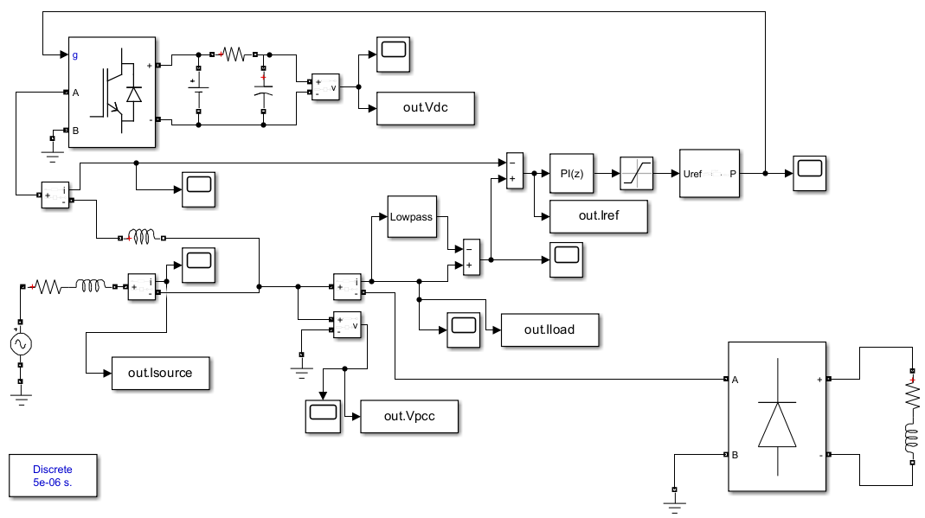
Conventional APF

Slide 9
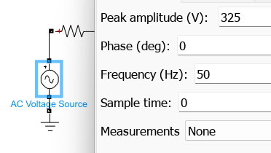
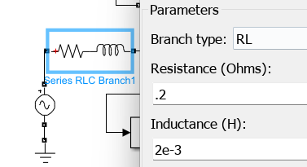
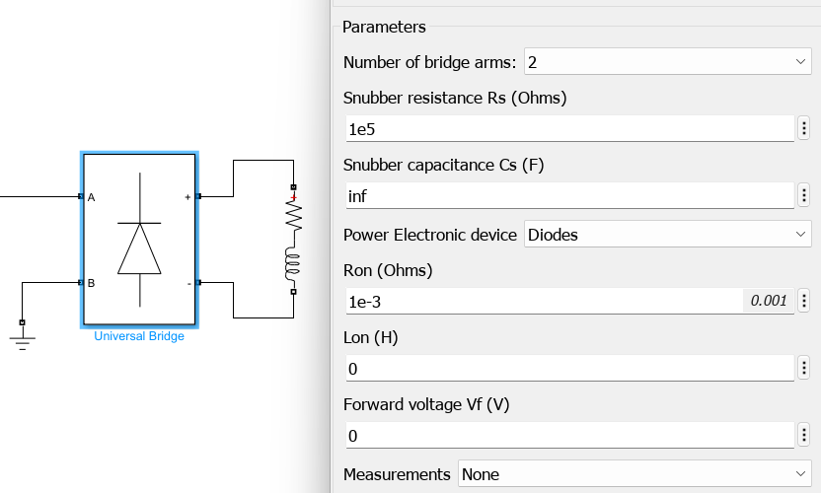
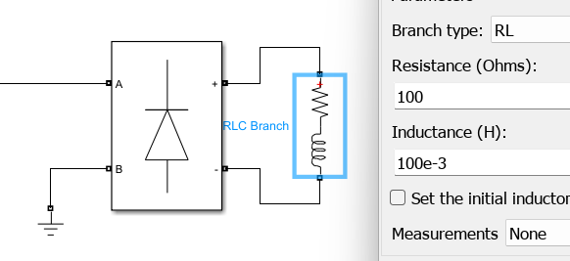
Simulation Conditions

Slide 10
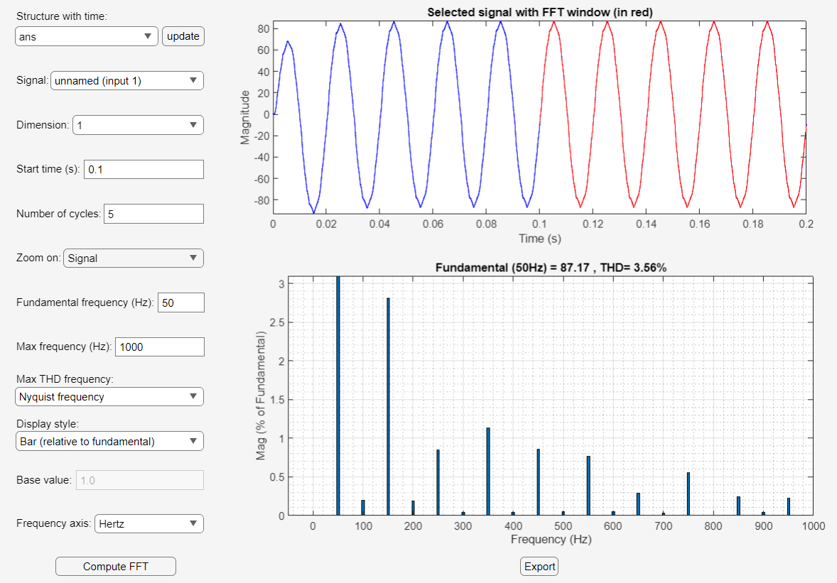
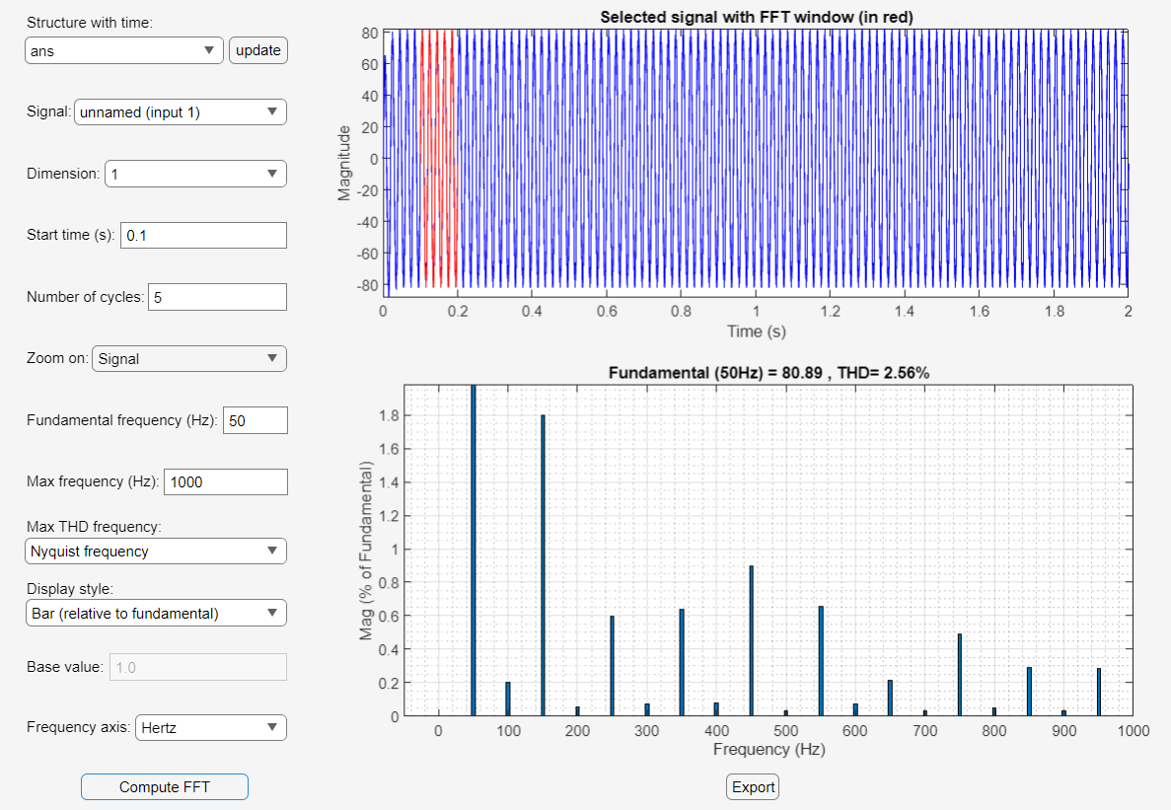
THD of Conventional APF

Slide 11
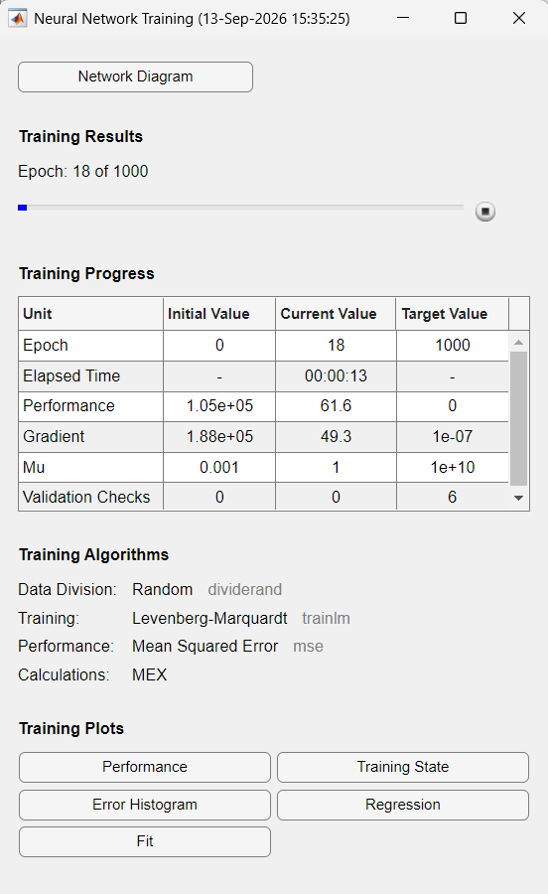
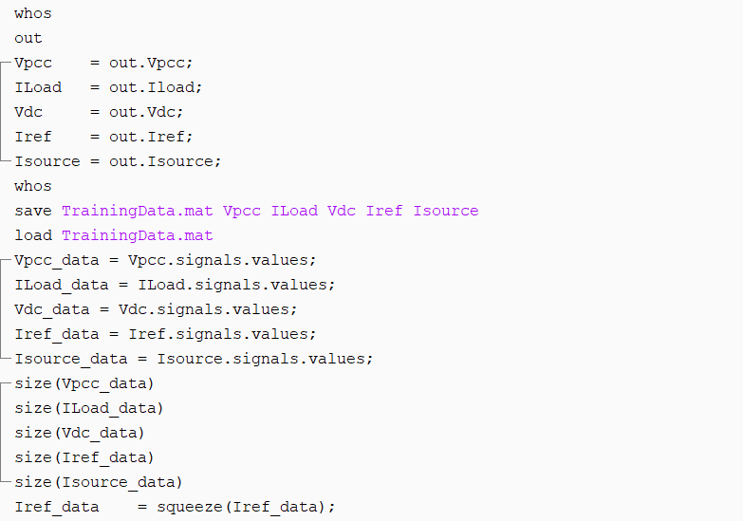
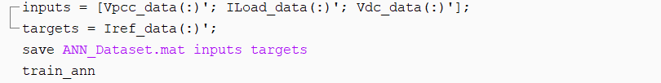
Dataset Generation

Slide 12
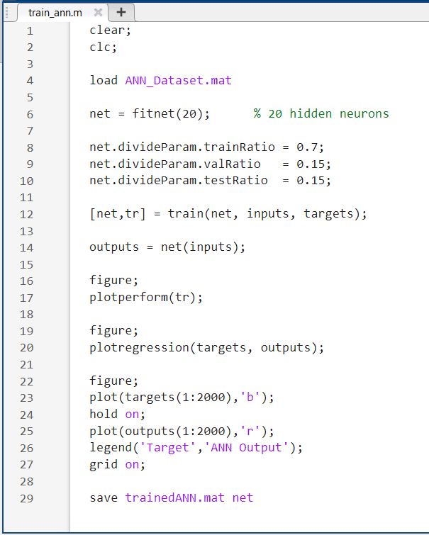
ANN Training Script

Slide 13
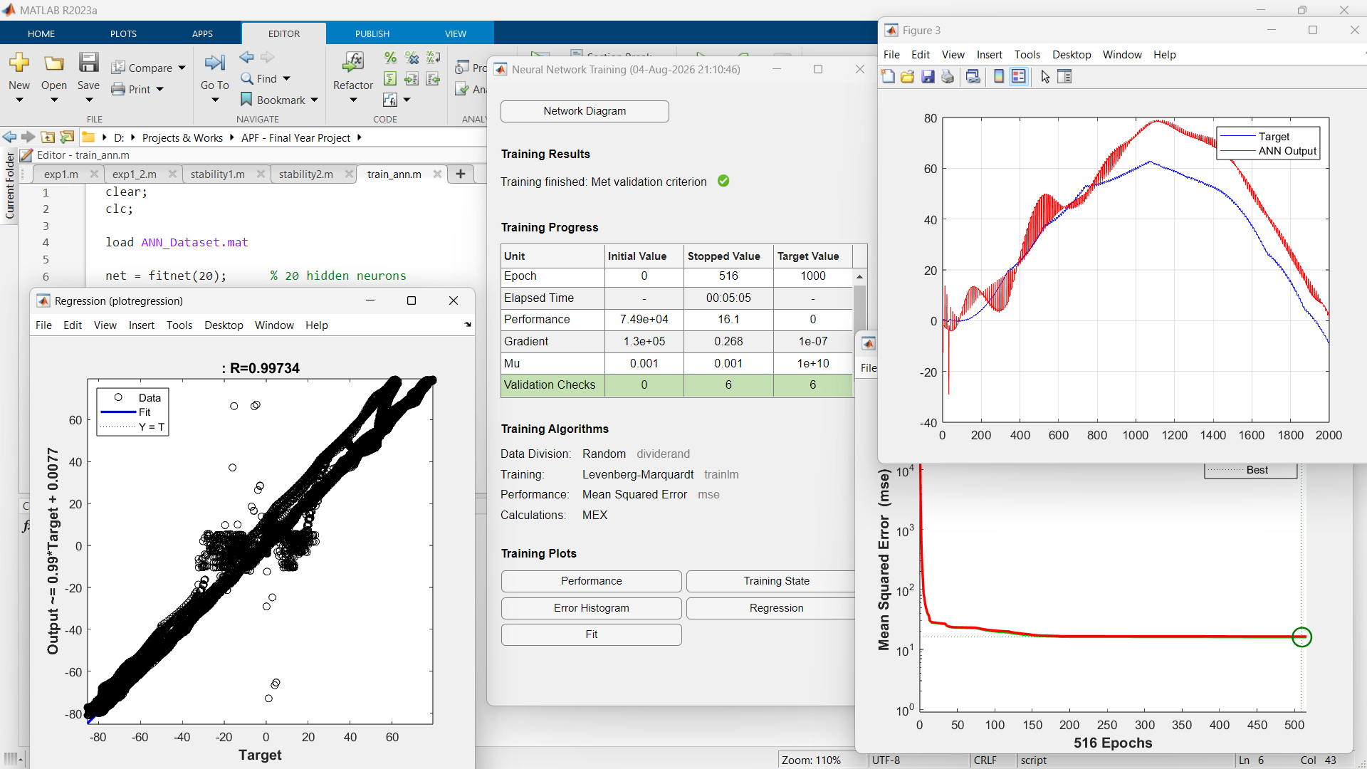

Slide 14
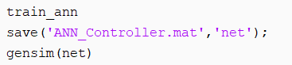
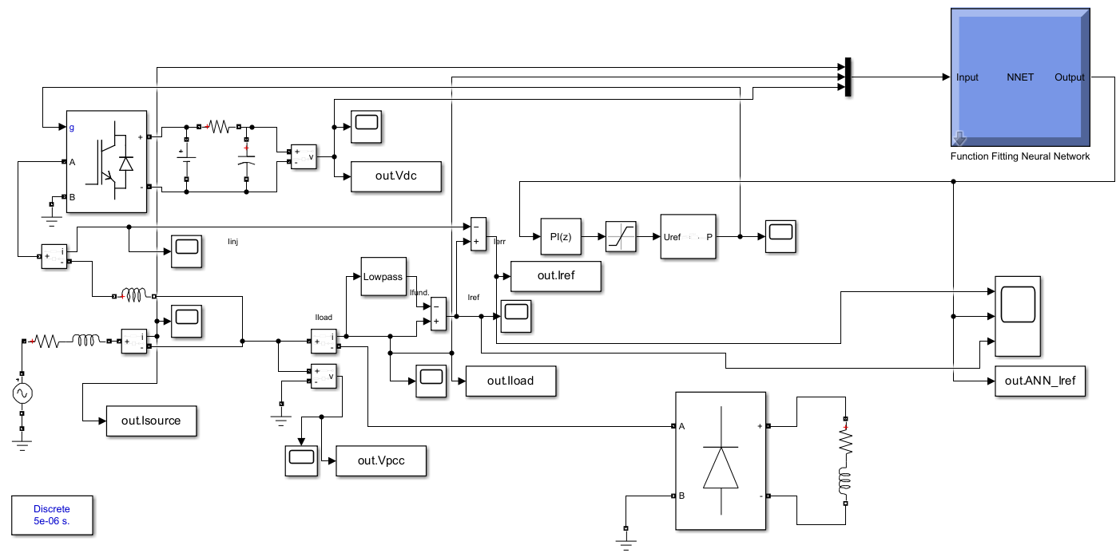
ANN Based APF

Slide 15
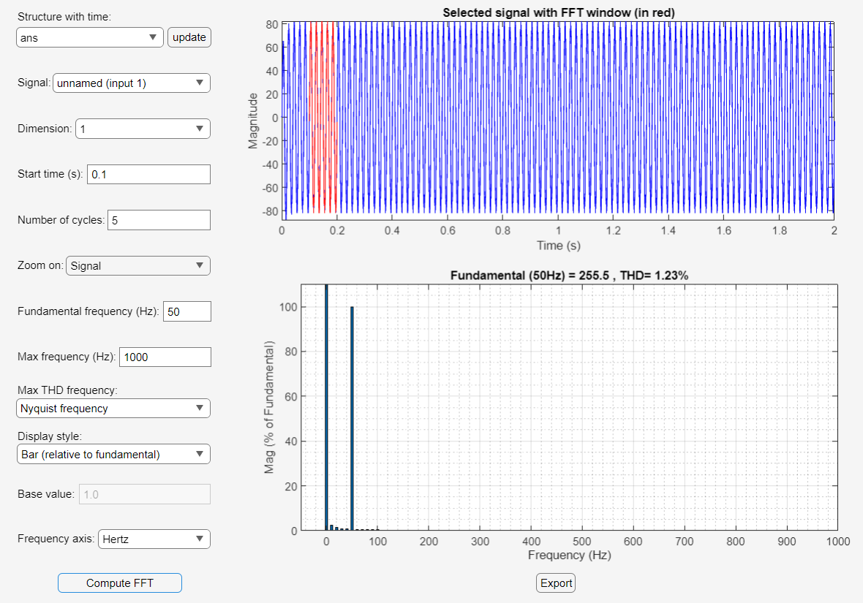
THD of ANN Based APF

Slide 16
Objectives
To Reduce THD
Learns the relationship between operating conditions and required compensation
Improved harmonic compensation under varying conditions

Slide 17
Thank You

